Slide 1
Welcome
DONG NAM PTROLEUM IND.CO.,LTD.
Electric Insulation Oil Since 1973
DONG NAM PETROLEUM IND. CO., LTD.
www.dongnampetro.com

Slide 2
Methods to Manage Transformer
in Maximizing its efficiency
Ro Chung Souk
CEO of Dong Nam Petroleum Ind. Co., Ltd.
DONG NAM PETROLEUM IND. CO., LTD.
www.dongnampetro.com

Slide 3
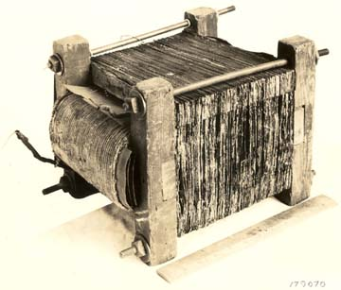
HISTORY OF TRANSFORMER OIL
Power transformers are based on the Principle of
Electromagnetic Inductions first invented in 1831
by Sir Michael Faraday.
Since then, the transformers have evolved insulating oils with it’s developments.
DONG NAM PETROLEUM IND. CO., LTD.
www.dongnampetro.com

Slide 4
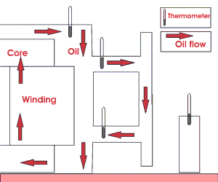
HISTORY OF TRANSFORMER OIL
Paraffinic base oils
_In 1884, used for the first closed core transformer
_Low viscosity
_Superior insulating effect with being impregnated into paper or solid dielectrics
_High pour points and insoluble sludge increasing the viscosity of the oil
_The viscosity is in inverse proportion to the heat dissipation rate
DONG NAM PETROLEUM IND. CO., LTD.
www.dongnampetro.com

Slide 5
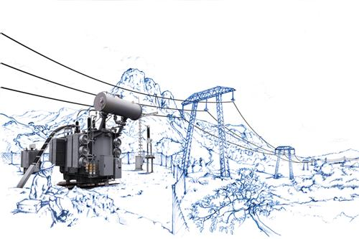
HISTORY OF TRANSFORMER OIL
Naphthenic oils
_Remaining fluid at low temperatures such as - 40℃
_ Highly flammable
Askarel base oils
_Used in 1932 to 1970s
_Synthetic fire resistant
_No longer environmentally acceptable to presence Polychlorinated Biphenyl (PCBs)
PCBs become concentrated in animal tissue and cause cancer in humans
DONG NAM PETROLEUM IND. CO., LTD.
www.dongnampetro.com

Slide 6
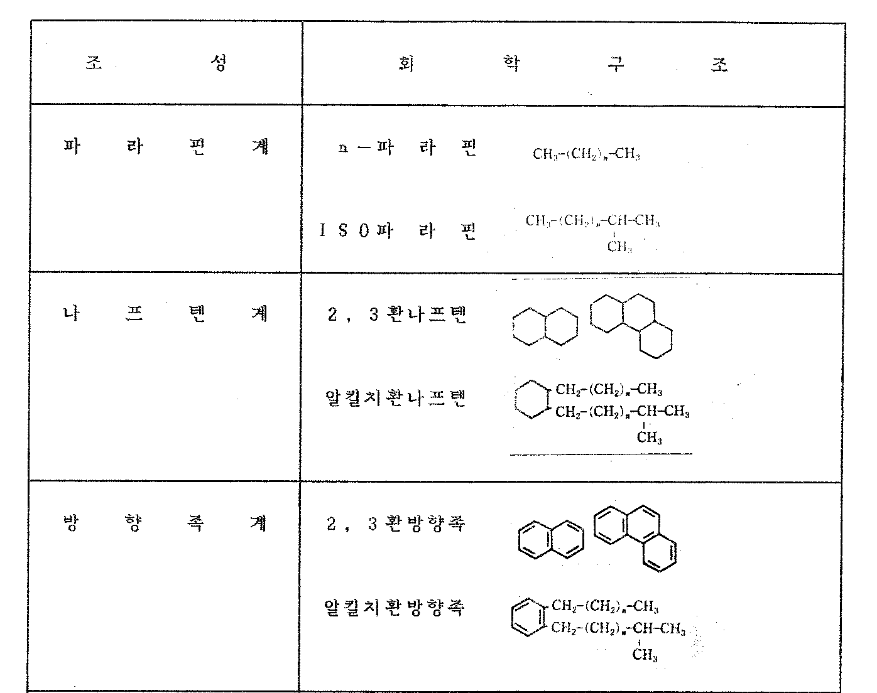
Properties of 2 Basic Types of Base Oils
Composition
Chemical structure
Paraffinic
Naphthenic
Aromatic
DONG NAM PETROLEUM IND. CO., LTD.
www.dongnampetro.com

Slide 7
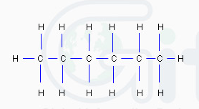
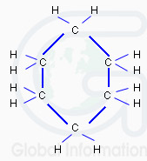
Specific Properties of Different Base Oil Feedstock
Naphthenic Base Oil
Paraffin Base Oil
Strengths:
Good Oxidation Stability
Good Chemical Stability
Weaknesses:
Vulnerable to Electricity Shock (Gassing)
Poor Thermal Stability
Strengths:
Good Thermal Stability.
Stable Electricity Shock
Weaknesses:
Poor Oxidation Stability
Poor Chemical Stability
DONG NAM PETROLEUM IND. CO., LTD.
www.dongnampetro.com

Slide 8
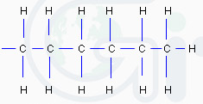
Properties Of DONGNAM ESTRAN Transformer Oil
ESTRAN is based on a unique patented
blend of paraffinic and naphthenic base oils,
which simply means it assumes the best
properties of these 2 base oils while
eliminating the natural shortcomings of each.
Strengths:
Excellent Oxidation Stability
Excellent Thermal Stability (Cooling)
Very Stable Dielectric Barrier
Resistant to Gassing Problem
Long service life
Weaknesses:
Not Useable in Extremely Low
Temperatures (Below - 45 ℃ )
ESTRAN Molecular Structure
DONG NAM PETROLEUM IND. CO., LTD.
www.dongnampetro.com

Slide 9
Emission of Transformer Insulation Oil Gas
Failures |  | Combustible Gases
Overheating of insulation oil | low temperature (300℃ or lower) | ethane (C₂H₆), methane CH₄), ethylene (C₂H₄)
 | mid temperature (300 - 700℃) | methane (CH₄), ethylene (C₂H₄), ethane (C₂H₆)
 | high temperature (700℃ or higher) | ethylene (C₂H₄), methane (CH₄), ethane (C₂H₆)
Overheating of solid insulation (200℃ or higher) |  | carbon monoxide (CO), carbon dioxide (CO₂), methane (CH₄)
Arc during insulting (1,000℃ or higher) |  | acetylene (C₂H₂), hydrogen(H₂), ethylene (C₂H₄), methane (CH₄)
Corona during insulating (1,000℃ or higher) |  | hydrogen (H₂), acetylene (C₂H₂), ethylene (C₂H₄), methane (CH₄)
Aging of insulation and/or insulation oil |  | carbon dioxide (CO₂), carbon monoxide (CO)
<Arc discharge>
Flow of strong current at rather low voltage can produce overheat by contact resistance at terminals of the electrode to produce heat and to evaporate electrode and to discharge by electrical steam.
<Corona discharge>
Strong electrical field at poles makes discharge when electrode of either one electrode or both electrodes is pointed.
Partial discharge at a part between electrodes differs from arc discharge.
<Source : KERI materials>
DONG NAM PETROLEUM IND. CO., LTD.
www.dongnampetro.com

Slide 10
Transformer oil-gas data analysis purposes
The gas was analyzed periodically by transformer oil two purposes.
KEPCO STANDARD (KOREA)
1. Early detection of more than a transformer inside the objective is to prevent accidents. - The hydrogen gas used here (H2) and acetylene (C2H2) gas as CO2 and hydrocarbon gases are excluded. 2. And diagnosing the degree of deterioration of the insulating material of the transformer in order to predict the remaining life of in order to determine the appropriate time to replace. - CO2 gas is used here, and CO gas.
Verdict | Caution |  | Abnormal |  | Danger
Voltage (kV)
Item | < 200 kV | > 345 kV | < 200 kV | > 345 kV | < 200 kV | > 345 kV
H₂ | 400~800 |  | 801~1,200
C₂H₂ | 25~80 | 20~60 | 81~100 | 61~80 | > 150 | > 120
CO | 400~700 | 350~600 | 701~1,000 | 601~800
C₂H₄ | 300~750 |  | 751~1,000
CH₄ | 250~750 |  | 751~1,000
C₂H₆ | 250~750 |  | 751~1,000
Total Combustible Gas (TCG) | 1,000~2,500 |  | 2,500 ~ 4,000 |  | > 4,000
TCG Gro | Stable |  | Initial Alert |  | High Alert/Immediate Action
 | > 200 / month |  | > 200 / month, |  | > 300 / month
Corrective Actions
 | Quarterly Monitoring |  | monthly. Monitoring |  | Immediate Internal Checking
DONG NAM PETROLEUM IND. CO., LTD.
www.dongnampetro.com

Slide 11
Recommended Transformer Oil Replacement Schedule
Items | Voltage (kV) STATUS | < 66 kV | 154kV ~ 200kV | > 345kV
Moisture | Normal | < 50 | < 40 | < 30
( ppm ) | Caution | 50~60 | 40~50 | 30~40
 | Faulty | > 60 | > 50 | > 40
Breakdown | Normal | > 30 | > 40 | > 50
Voltage | Caution | - | 30~40 | 40~50
( kV ) | Faulty | < 30 | < 30 | < 40
Total Acid Value | Normal | < 0.20 | < 0.10
( mg KOH/g ) | Caution | 0.21~0.40 | 0.11~ 0.30
 | Faulty | > 0.41 | > 0.31
 | Normal | Every Three years
 | Caution | Every year | Every 6 months (Breakdown Voltage)
Cycle Analysis |  |  | Every year (Moisture, Total Acid Value )
 | Faulty | 1. Comprehensive quality assessment through precise analysis.
 |  | 2. Actions based on analysis results.
KEPCO STANDARD (KOREA)
DONG NAM PETROLEUM IND. CO., LTD.
www.dongnampetro.com

Slide 12
Transformer Oil Types – Gas Analysis Result Table(ASTM D 3612 method C)
 |  | O2 | N2 | CO2 | H2 | C2H2 | C2H4 | C2H6 | CH4 | CO | TCG
Paraffin oil #1 | After 336 hours after heating | - | - | 5,639 | - | - | 19 | 1,015 | 26 | 119 | 1,179
Naphthenic oil #1 | After 336 hours after heating | - | - | 4,585 | - | - | 3 | 515 | 108 | 190 | 817
Paraffin + Naphthenic | After 336 hours after heating | - | - | 5,137 | - | - | 8 | 689 | 73 | 324 | 1,094
<105 ℃ , 336hr
Degradation test. >
DONG NAM PETROLEUM IND. CO., LTD.
www.dongnampetro.com

Slide 13
Specifications of ESTRAN U type & I type
CHARACTERISTICS |  |  |  | Unit | Method | Specification | ESTRAN U Type | Specification | ESTRAN I Type
 |  |  |  |  |  | IEC60296 U TYPE |  | IEC60296 I TYPE
Density (at 20 ℃) |  |  |  |  | ISO 3675 | 0.895 Max | 0.8270 | 0.895 Max | 0.8270
Appearance |  |  |  |  | IEC 60296 | Clear | Clear | Clear | Clear
Viscosity (at -30 ℃) |  |  |  | cSt | ISO 3104 | 1800 Max | 241.0 | 1800 Max | 241.0
Viscosity (at 40 ℃) |  |  |  | cSt | ISO 3104 | 12.0 Max | 7.587 | 12.0 Max | 7.587
Flash Point |  |  |  | ℃ | ISO 2719 | 135 Min | 150 | 135 Min | 150
Pour Point |  |  |  | ℃ | ISO 3016 | -40.0 Max | < -42.0 | -40.0 Max | < -42.0
Acidity Value |  |  |  | mg KOH/g | IEC 62021-1 | 0.01 Max | 0.006 | 0.01 Max | 0.006
Corrosive Sulfur |  |  |  |  | DIN 51353 | Not Corrosive | Not Corrosive | Not Corrosive | Not Corrosive
Water Content |  |  | Drum | mg/kg | IEC 60814 | 40 Max | <20.0 | 40 Max | <20.0
 |  |  | Bulk |  |  | 30 Max | _ | 30 Max | _
Oxidation Stability | TEST duration |  | Sludge | % | IEC 61125(Method C) | 0.8 Max | 0.22 | 0.8 Max | 0.27
 | U Type (164h/120℃) |  | T.A.V | mg KOH/g | IEC 61125(Method C) | 1.2 Max | 0.36 | 1.2 Max | 0.20
 | I Type (500h/120℃) |  | DDF at 90℃ |  | IEC 60247 | 0.5 Max | 0.042 | 0.5 Max | 0.058
Antioxidant additive |  |  | U Type | % | IEC 60666 | Not detectable | Not detectable | - | -
 |  |  | I Type | % | IEC 60666 | - | - | 0.08 ~ 0.40 | <0.4
Breakdown Voltage |  | As delivered |  | kV | IEC 60156 | 30 Min | 72 | 30 Min | 70
 |  | After treatment |  |  | IEC 60156 | 70 Min | > 80 | 70 Min | >80
Dissipation Factor (40-60Hz, 90℃) |  |  |  |  | IEC 60247 / IEC 61620 | 0.005 Max | 0.0005 | 0.005 Max | 0.0005
PCB Content |  |  |  | ppm | IEC 61619 | Not detectable | Not detectable | Not detectable | Not detectable
DONG NAM PETROLEUM IND. CO., LTD.
www.dongnampetro.com

Slide 14
Comparison with other companies’ products overseas
CHARACTERISTICS |  | Unit | TEST METHOD | SPECIFICATION | DONG NAM ESTRAN | SHELL DIALA D | NYNAS LIBRA | SHELL DIALA B | ERGON HyVolt I
Density 20℃ |  | kg/dm³ | ISO 3675 | 0.895 Max | 0.827 | 0.881 | 0.875 | 0.881 | 0.881
Viscosity | -30℃ | cSt | ISO 3104 | 1,800 Max | 241.0 | 730 | 1100 | 1400 | 1291
 | 40℃ | cSt |  | 12.0 Max | 7.587 | 8.100 | 9.600 | 10.00 | 10.3
Flash Point P.M |  | ℃ | ISO 2719 | 135 Min | 150 | 140 | 152 | 140 | 146
Pour Point |  | ℃ | ISO 3016 | -40 Max | -42.0 | < -50 | -51 | < -50 | -62
Acidity Value |  | mg KOH/g | IEC 62021-1 | 0.01 Max | < 0.01 | < 0.01 | < 0.01 | < 0.01 | < 0.01
Corrosive Sulphur |  |  | DIN 51353 | Not corrosive | Not corrosive | Not corrosive | Not corrosive | Not corrosive | Not corrosive
Water Content | Bulk | mg/kg | IEC 60814 | 30 Max | < 15 | < 30 | < 30 | 30 | 15
 | Drum |  |  | 40 Max | - | < 40 | - | 40
Anti-Oxidant Additives | Uninhibited | wt% | IEC 60666 | Not Detectable | Not Detectable | Not Detectable | Not Detectable | Not Detectable | Not Detectable
Breakdown Voltage | as delivered | kV | IEC 60156 | 30 Min | 68 | > 30 | 40 ~ 60 | > 30 | 55
 | after treatment |  |  | 70 Min | 75 | > 70 | > 70 | > 70 | 75
Oxidation Stability (164hrs * 120℃) | Sludge | % | IEC 61125 (Method C) | 0.8 Max | 0.22 | 0.15 | 0.18 | 0.30 | 0.20
 | Acid Value | mgKOH/g |  | 1.2 Max | 0.36 | 0.23 | 0.55 | 0.90 | 0.70
P.C.Bs Content |  |  | IEC 61619 | Not Detectable | Not Detectable | Not Detectable | Not Detectable | Not Detectable | Not Detectable
Dissipation Factor DDF 90℃ |  |  | IEC 60247 | 0.005 Max | <0.001 | 0.001 | < 0.001 | 0.002 | 0.001
DONG NAM PETROLEUM IND. CO., LTD.
www.dongnampetro.com

Slide 15


Result of mixing ESTRAN & NYNAS’s LIBRA
CHARACTERISTICS |  |  | Unit | TEST METHOD | SPECIFICATION | ESTRAN (DONGNAM) | ESTRAN 90% + LIBRA 10% | ESTRAN 70% + LIBRA 30% | ESTRAN 50% + LIBRA 50% | ESTRAN 30% + LIBRA 70% | ESTRAN 10% + LIBRA 90% | LIBRA (NYNAS)
Density 20℃ |  |  | kg/dm³ | ISO 3675 | 0.895 Max | 0.8270 | 0.832 | 0.841 | 0.851 | 0.861 | 0.870 | 0.875
Viscosity | -30℃ |  | cSt | ISO 3104 | 1,800 Max | 241.0 | 548 | 671 | 794 | 916 | 1039 | 1100
 | 40℃ |  | cSt |  | 12.0 Max | 7.587 | 8.598 | 8.821 | 9.044 | 9.266 | 9.489 | 9.600
Flash Point P.M |  |  | ℃ | ISO 2719 | 135 Min | 150 | 150 | 150 | 150 | 150 | 150 | 152
Pour Point |  |  | ℃ | ISO 3016 | -40 Max | <-42.0 | -45.0 | -48.0 | -48.0 | -48.0 | -48.0 | -51
Acidity Value |  |  | mg KOH/g | IEC 62021-1 | 0.01 Max | < 0.01 | < 0.01 | < 0.01 | < 0.01 | < 0.01 | < 0.01 | < 0.01
Corrosive Sulphur |  |  |  | DIN 51353 | Not corrosive | Not corrosive | Not corrosive | Not corrosive | Not corrosive | Not corrosive | Not corrosive | Not corrosive
Water Content |  | Bulk | mg/kg | IEC 60814 | 30 Max | < 15 | < 15 | < 15 | < 20 | < 20 | < 25 | < 30
 |  | Drum |  |  | 40 Max | < 25 | < 25 | < 25 | < 30 | < 30 | < 35 | < 40
Anti-Oxidant Additives |  | Uninhibited | wt% | IEC 60666 | Not Detectable | Not Detectable | Not Detectable | Not Detectable | Not Detectable | Not Detectable | Not Detectable | Not Detectable
Breakdown Voltage |  | as delivered | kV | IEC 60156 | 30 Min | > 68 | > 60 | > 60 | > 60 | 60 | < 60 | 40 ~60
 |  | after treatment |  |  | 70 Min | > 75 | > 70 | > 70 | > 70 | > 70 | 70 | > 70
Oxidation Stability (164hrs * 120℃) |  | Sludge | % | IEC 61125 (Method C) | 0.8 Max | 0.22 | 0.213 | 0.210 | 0.198 | 0.192 | 0.188 | 0.18
 |  | Acid Value | mg KOH/g |  | 1.2 Max | 0.36 | 0.379 | 0.417 | 0.455 | 0.493 | 0.541 | 0.55
P.C.Bs Content |  |  |  | IEC 61619 | Not Detectable | Not Detectable | Not Detectable | Not Detectable | Not Detectable | Not Detectable | Not Detectable | Not Detectable
Dissipation Factor DDF 90℃ |  |  |  | IEC 60247 | 0.005 Max | < 0.001 | < 0.001 | < 0.001 | < 0.001 | < 0.001 | < 0.001 | < 0.001
DONG NAM PETROLEUM IND. CO., LTD.
www.dongnampetro.com

Slide 16


“Human
Natural
Technology”
31, WONSI-RO, DANWON-GU, ANSAN-SI, GYUNGGI-DO, REPUBLIC OF KOREA
TEL : 82-31-495-3951
FAX : 82-31-491-8463

